Slide 1
CS101 Algorithms and Data Structures
A* search and Backtracking
Notes:
Adapted from the slides by Douglas Wilhelm Harder of U Waterloo (https://ece.uwaterloo.ca/~dwharder/aads/Lecture_materials/)
May also contain material from the slides at https://courses.cs.washington.edu/courses/cse326/03wi/326lecturesb.shtml (by Dan Suciu of U Washington)

Slide 2
Outline of A* Search Algorithm
For A* search algorithm, we will cover:
It solves the single-source shortest path problem
Restricted to physical environments
First described in 1968 by Peter Hart, Nils Nilsson, and Bertram Raphael
Similar to Dijkstra’s algorithm
Uses a hypothetical shortest distance to weight the paths

Slide 3
Background
Assume we have a heuristic lower bound for the length of a path between any two vertices
E.g., a graph embedded in a plane
the shortest distance is the Euclidean distance
“as the crow flies”
use this to guide our search for a path
“as the fox runs”

Slide 4
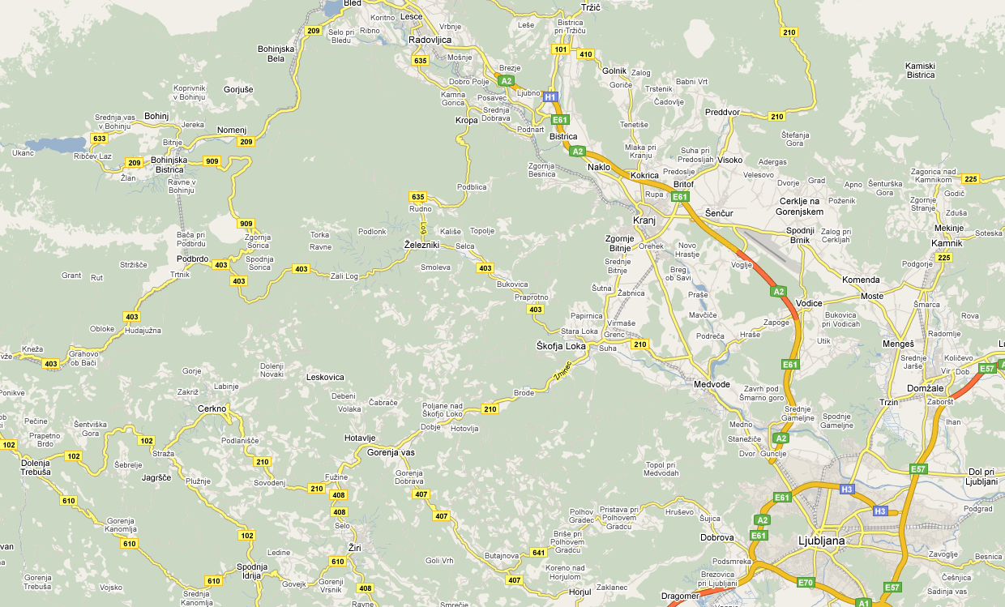
Idea
Consider this map of Slovenia

Slide 5
Idea
Suppose we want to go from Kamnik to Bohinj

Slide 6
Idea
A lower bound for the length of the shortest path to Bohinj is h(Kamnik, Bohinj) = 53 km
53 km

Slide 7
Idea
Any actual path must be at least as long as 53 km
53 km

Slide 8
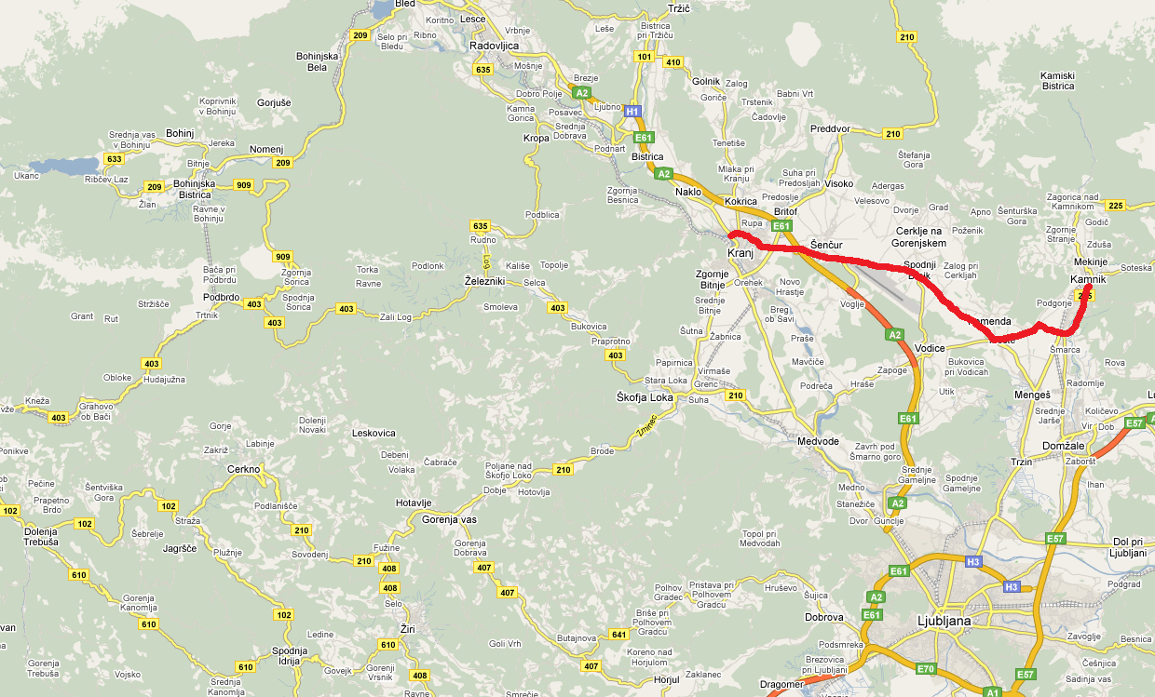
Idea
Suppose we have a 28 km shortest path from Kamnik to Kranj: d(Kamnik, Kranj) = 28 km
28 km

Slide 9
Idea
A lower bound on the shortest distance from Kranj to the destination is now h(Kranj, Bohinj) = 32 km
32 km
28 km

Slide 10
Idea
Thus, the weight of the path up to Kranj is
w(Kranj) = d(Kamnik, Kranj) + h(Kranj, Bohinj) = 60 km
32 km
28 km

Slide 11
Idea
Any path extending this given path to Bohimj must be at least 60 km
32 km
28 km

Slide 12
Idea
The value w(Kranj) represents the shortest possible distance from Kamnik to Bohinj given that we follow the path to Kranj
As with Dijkstra’s algorithm, we must start with the null path starting at Kamnik:
w(Kamnik) = d(Kamnik, Kamnik) + h(Kamnik, Bohimj)
= 0 km + 53 km
Bohimj
53 km
Kamnik

Slide 13
Algorithm Description
Suppose we are finding the shortest path from vertex a to a vertex z
The A* search algorithm initially:
Marks each vertex as unvisited
Starts with a priority queue containing only the initial vertex a
The priority of any vertex v in the queue is the weight w(v) which assumes we have found the shortest path to v (initialize it to be infinity except for the initial vertex a)
Shortest weights have highest priority
For each vertex v, d(a, v) is the shortest known distance from a to v, d(a, a) = 0 and d(a, v)= infinity for all v ≠ a
For each vertex v, h(v, z) is the heuristic distance from v to z

Slide 14
Algorithm Description I (Tree Search)
The algorithm then iterates:
Pop the vertex u with highest priority
For each adjacent vertex (neighbor) v of u:
If w(v) = d(a, u) + d(u, v) + h(v, z) is less than the current weight/priority of v, update the path leading to v and its priority
If v is not in the queue, push v into the queue
Continue iterating until the item popped from the priority queue is the destination vertex z

Slide 15
Algorithm Description II (Graph Search)
The algorithm then iterates:
Pop the vertex u with highest priority
mark u as visited
For each unvisited adjacent vertex (neighbor) v of u:
If w(v) = d(a, u) + d(u, v) + h(v, z) is less than the current weight/priority of v, update the path leading to v and its priority
If v is not in the queue, push v into the queue
Continue iterating until the item popped from the priority queue is the destination vertex z
Note: Tree Search or Graph Search are just two different ways to search the solution.

Slide 16
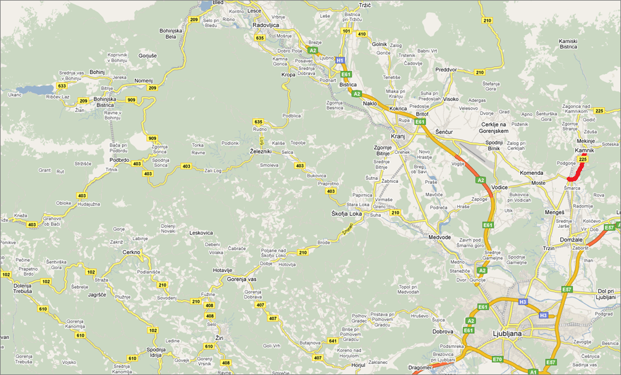
Comparison of Priorities
Suppose we have a path with
w(Smarca) = 4 km + 52 km = 56 km
52 km
4 km

Slide 17
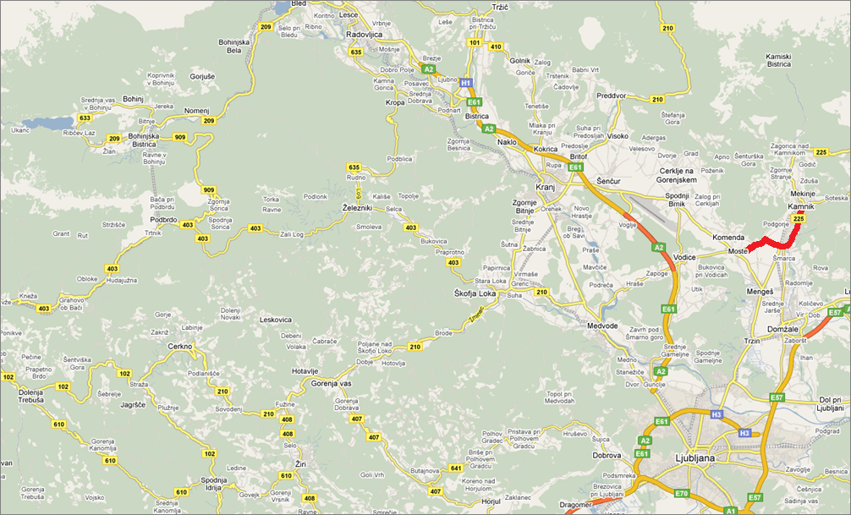
Comparison of Priorities
We can extend this path to Moste:
w(Moste) = 4 km + 5 km + 48 km = 57 km
48 km
9 km

Slide 18

Comparison of Priorities
We can also extend this path to Menges:
w(Menges) = 4 km + 4 km + 51 km = 59 km
51 km
8 km

Slide 19
Comparison of Priorities
The smaller weight path to Moste has priority—extend it first
48 km
9 km

Slide 20
Comparison with Dijkstra’s Algorithm
This differs from Dijkstra’s algorithm which gives weight only to the known path
Dijkstra would chose Menges next:
d(Kamnik, Moste) = 9 km > 8 km = d(Kamnik, Menges)
Difference:
Dijkstra’s algorithm radiates out from the initial vertex
The A* search algorithm directs its search towards the destination

Slide 21
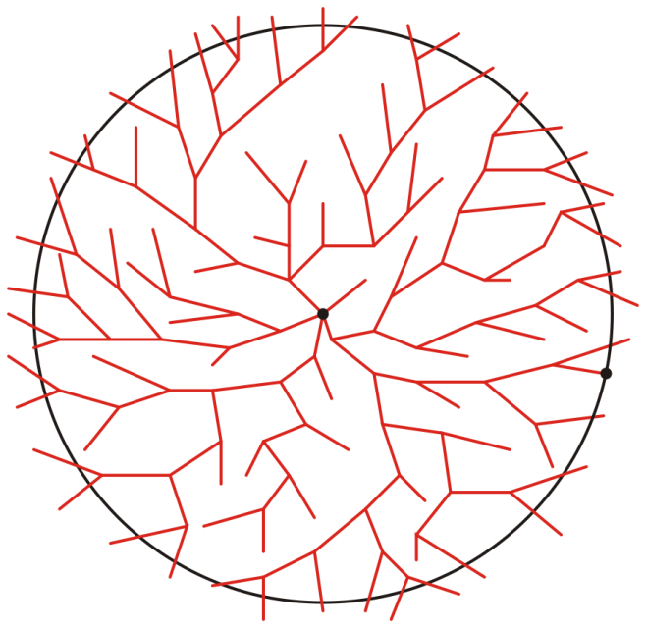
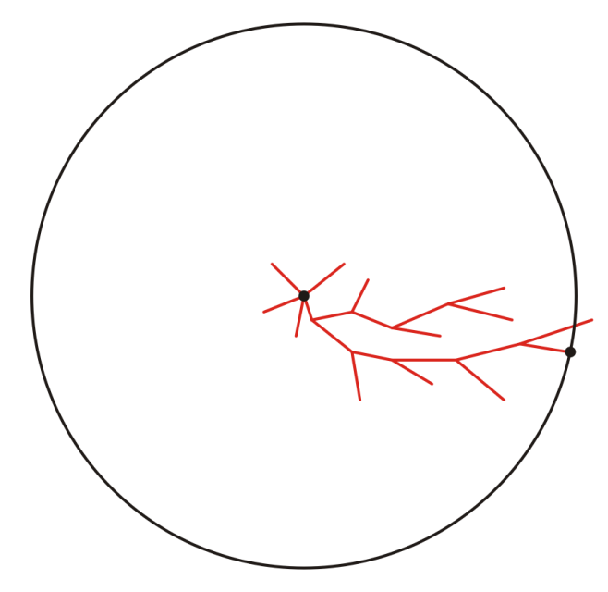
Comparison with Dijkstra’s Algorithm
Graphically, we can suggest the behaviour of the two algorithms as follows:
Suppose we are moving from a to z:
a
a
z
z
Representative search patterns for Dijkstra’s and the A* search algorithms

Slide 22
Comparison with Dijkstra’s Algorithm
Dijkstra’s algorithm is the A* search algorithm when the heuristic distance
No vertex is better than any other vertex
a
a
z
z
Representative search patterns for Dijkstra’s and the A* search algorithms

Slide 23
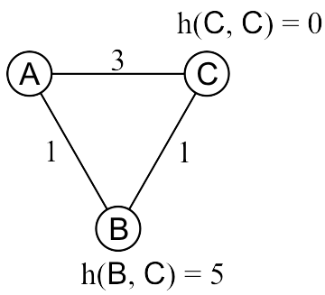
Optimally Guarantees?
The A* search algorithm will not always find the optimal path with a poor heuristic distance
Find the shortest path from A to C:
B is enqueued with weight w(B) = 1 + 5 = 6
C is enqueued with weight w(C) = 3 + 0 = 3
Therefore, C is dequeued next and as it is the destination, we are finished
Reference: Andrew Moore, Carnegie Mellon University
Notes:
23

Slide 24
Admissible Heuristics
This heuristic overestimates the actual distance from B to C
The Euclidean distance doesn’t suffer this problem:
The path the crow flies is always shorter than the road the wolf runs
Reference: Andrew Moore, Carnegie Mellon University
Notes:
24

Slide 25
Admissible Heuristics
Admissible heuristics h must always be optimistic:
Let d(u, v) represent the actual shortest distance from u to v
A heuristic h(u, v) is admissible if h(u, v) ≤ d(u, v)
The heuristic is optimistic or a lower bound on the distance
Using the Euclidean distance between two points on a map is clearly an admissible heuristic
The flight of the crow is shorter than the run of the wolf
A problem with fewer restrictions on the actions is called a relaxed problem
The cost of an optimal solution to a relaxed problem is an admissible heuristic for the original problem
Theorem:
If h(n) is admissible, A* using TREE-SEARCH is optimal.
Notes:
25

Slide 26
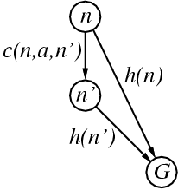
Consistent Heuristics
A heuristic is consistent if for every node n, every successor n' of n generated by any action a, we have
h(n) ≤ c(n,a,n') + h(n')
If h is consistent, we have
w(n’) = d(n’) + h(n’) (by def.)
= d(n) + c(n,a,n') + h(n’) (d(n’)=d(n)+c(n.a.n’))
≥ d(n) + h(n) = w(n) (consistency)
w(n’) ≥ w(n)
i.e., w(n) is non-decreasing along any path.
Theorem:
If h(n) is consistent, A* using GRAPH-SEARCH is optimal.
It’s the triangle
inequality !
keeps all checked nodes
in memory to avoid repeated states

Slide 27
Time Complexity
Exponential: O(b^{d}) where b is the branching factor (the average number of successors per state) and d is the depth of the solution
Can be shown to run in polynomial time if
|h(u, v) – d(u, v)| = O(ln(d(u, v)))
where d(u, v) is the length of the actual shortest path¹
I.e., doubling the length of the optimal solution only increases the error by a constant
Not likely with a road map and the Euclidean distance
E.g. when h(u, v) = d(u, v)
¹Pearl, Judea (1984). Heuristics: Intelligent Search Strategies for Computer Problem Solving. Addison-Wesley.

Slide 28
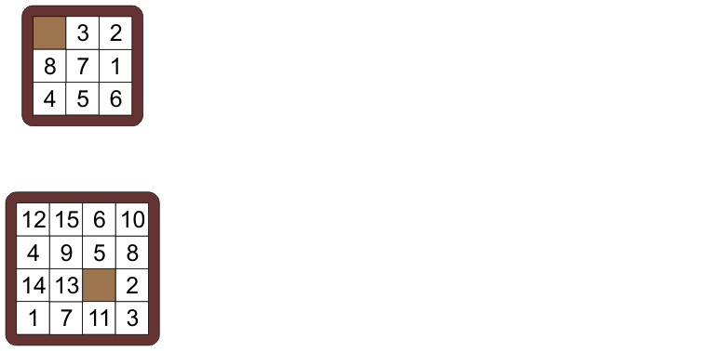
The N Puzzle
Consider find the solution to the following puzzle
Take a random permutation of 8 or 15 numbered tiles and a blank formed in a rigid square
Reference: Andrew Moore, Carnegie Mellon University
Notes:
28

Slide 29
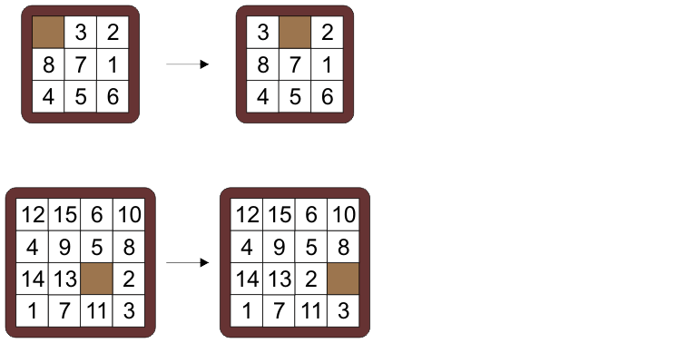
The N Puzzle
You are allowed to move a tile adjacent to the blank into the location of the blank
Notes:
29

Slide 30
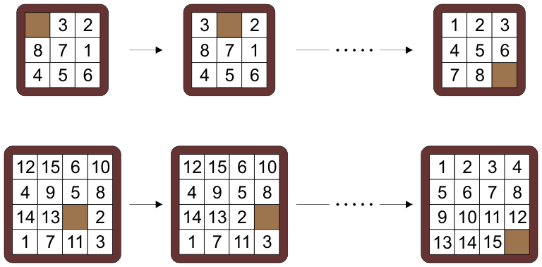
The N Puzzle
The objective is to find a minimum number of moves which will transform the tiles into a standard solution
Notes:
30

Slide 31
The N Puzzle
There are 9! and 16! initial permutations
Half of these, through a sequence of moves, can be transformed into the desired solutions
Notes:
31

Slide 32
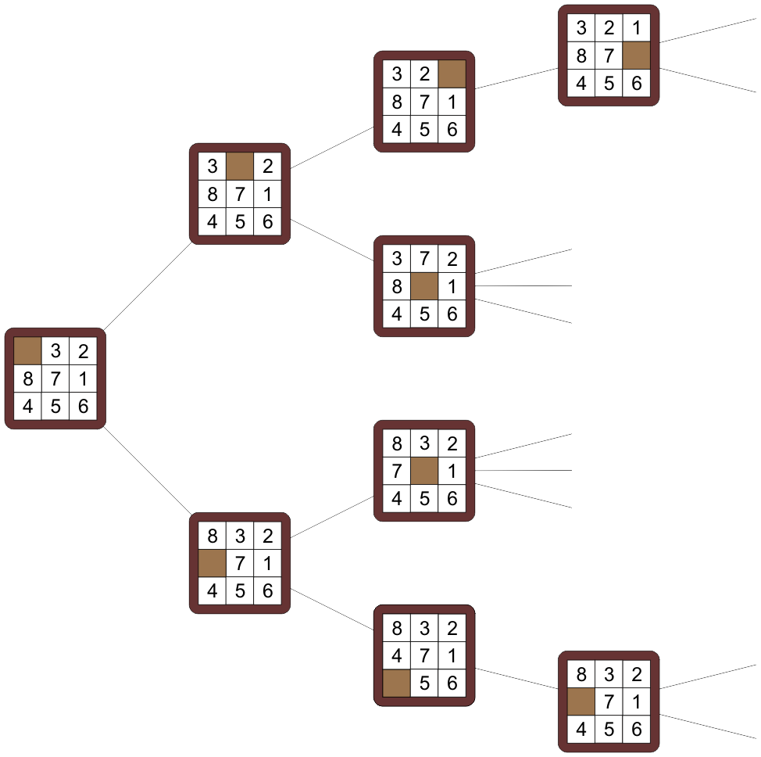
The N Puzzle
Each solution defines a vertex in a graph with edges denoting allowable moves
It is not a tree, but the smallest cycle has a length of 12
E.g., cycle 8, 7, and 3
Notes:
32

Slide 33
The N Puzzle
The graph of solvable eight puzzles has:
181 440 vertices
241 920 edges
The fifteen puzzle graph has:
10 461 394 944 000 vertices
15 692 092 416 000 edges
In general and in the limit:
(N + 1)!/2 vertices
(N + 1)! edges
Notes:
33

Slide 34
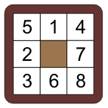
The N Puzzle
Finding a solution requires one to find the shortest path
All edges have weight 1
Dijkstra’s algorithm is painfully slow
This puzzle requires that 179680 vertices be searched
To use the A* search, we need a heuristic lower bound on the distance
Notes:
34

Slide 35
The N Puzzle
We will consider three distances which we will use with the A* search:
The discrete distance
If two objects are equal, the distance is 0, otherwise it is 1
The Hamming distance
The number of tiles (including the blank) which are in an incorrect location
The Manhattan distance
The sum of the minimum number of moves required to put a tile in its correct location
Notes:
35

Slide 36
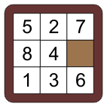
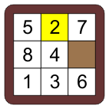
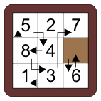
The N Puzzle
For example, consider this permutation:
It does not equal the solution, so the discrete distance is 1
8 out of 9 tiles/blanks are in the incorrect location; therefore the Hamming distance is 8
It requires 2 + 0 + 4 + 2 + 1 + 1 + 2 + 3 + 1 = 16 moves to move each tile into the correct location, therefore the Manhattan distance is 16

Slide 37
The N Puzzle
As discussed before, the discrete distance does not improve the situation: it is equivalent to Dijkstra’s algorithm
Using the same permutation as before:
The Hamming distance isn’t much better:
It reduces the vertices searched from 179 680 to 178 005
It is only useful when we are very close to the actual solution
The Manhattan distance, however, allows the A* search to find the minimal path with only 6453 vertices searched

Slide 38
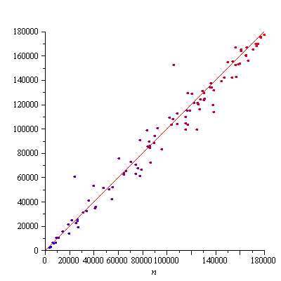
The N Puzzle
How much better is it to use the Manhattan distance over the Hamming or discrete?
With the Hamming distance, there is only a small change
For 100 random puzzles, we have a plot the number of vertices visited using the discrete distance versus the number of vertices visited using the Hamming distance
The line is the identity function
The colour, blue to red, indicates the length of the solution; from 13 to 28

Slide 39
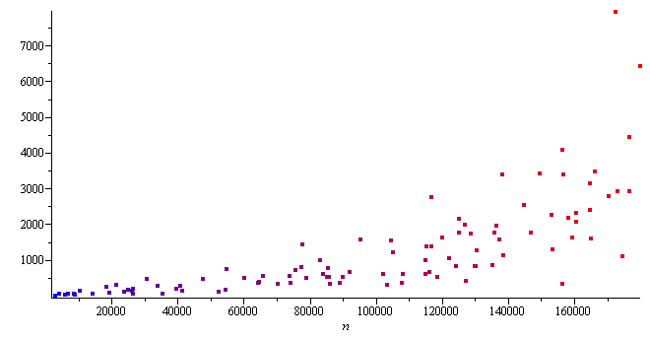
The N Puzzle
However, comparing the number of vertices visited when using the Manhattan distance, there is a significant reduction by a factor of almost 100
A more significant improvement with shorter paths

Slide 40
Summary
This topic has presented the A* search algorithm
Assumes a hypothetical lower bound on the length of the path to the destination
Requires an appropriate heuristic
Useful for Euclidean spaces (vector spaces with a norm)
Faster than Dijkstra’s algorithm in many cases
Directs searches towards the solution

Slide 41
Backtracking (Optional)
Suppose a solution can be made as a result of a series of choices
Each choice forms a partial solution
These choices may form either a tree or DAG
Separate branches may recombine or diverge

Slide 42
Backtracking
With Dijkstra’s algorithm, we keep track of all current best paths
There are at most |V| – 1 paths we could extend at any one time
These can be tracked with a relatively small table
Suppose we cannot evaluate the relative fitness of solutions
There may just be too many to record efficiently
Are we left with a brute-force search?
Suppose there are just too many partial solutions at any one time to keep track of
At any point in time in a game of chess or Go (围棋), there are a plethora of moves, each valid, but the usefulness of each will vary

Slide 43
Sudoku
In the first case, consider the game Sudoku:
The search space is 9⁵³
5 |  | 4 |  |  |  |  | 6
 | 6 |  | 3 |  |  | 1
 | 9 | 2 | 5 | 4
6 |  | 8 |  |  | 1
 |  |  | 8 |  | 4
 |  |  | 2 |  |  | 6 |  | 1
 |  |  |  | 9 | 5 | 8 | 1
 |  | 1 |  |  | 2 |  | 3
 | 8 |  |  |  |  | 2 |  | 7
http://www.sudokuoftheday.com/

Slide 44
Sudoku
At least for the first entry in the first square, only 1, 3, 7 fit
5 |  | 4 |  |  |  |  | 6
 | 6 |  | 3 |  |  | 1
 | 9 | 2 | 5 | 4
6 |  | 8 |  |  | 1
 |  |  | 8 |  | 4
 |  |  | 2 |  |  | 6 |  | 1
 |  |  |  | 9 | 5 | 8 | 1
 |  | 1 |  |  | 2 |  | 3
 | 8 |  |  |  |  | 2 |  | 7
5 | 1 | 4 |  |  |  |  | 6
 | 6 |  | 3 |  |  | 1
 | 9 | 2 | 5 | 4
6 |  | 8 |  |  | 1
 |  |  | 8 |  | 4
 |  |  | 2 |  |  | 6 |  | 1
 |  |  |  | 9 | 5 | 8 | 1
 |  | 1 |  |  | 2 |  | 3
 | 8 |  |  |  |  | 2 |  | 7
5 | 3 | 4 |  |  |  |  | 6
 | 6 |  | 3 |  |  | 1
 | 9 | 2 | 5 | 4
6 |  | 8 |  |  | 1
 |  |  | 8 |  | 4
 |  |  | 2 |  |  | 6 |  | 1
 |  |  |  | 9 | 5 | 8 | 1
 |  | 1 |  |  | 2 |  | 3
 | 8 |  |  |  |  | 2 |  | 7
5 | 7 | 4 |  |  |  |  | 6
 | 6 |  | 3 |  |  | 1
 | 9 | 2 | 5 | 4
6 |  | 8 |  |  | 1
 |  |  | 8 |  | 4
 |  |  | 2 |  |  | 6 |  | 1
 |  |  |  | 9 | 5 | 8 | 1
 |  | 1 |  |  | 2 |  | 3
 | 8 |  |  |  |  | 2 |  | 7

Slide 45
Sudoku
If the first entry has a 1, the 2nd entry in that square could be 7 or 8
5 | 1 | 4 |  |  |  |  | 6
 | 6 |  | 3 |  |  | 1
 | 9 | 2 | 5 | 4
6 |  | 8 |  |  | 1
 |  |  | 8 |  | 4
 |  |  | 2 |  |  | 6 |  | 1
 |  |  |  | 9 | 5 | 8 | 1
 |  | 1 |  |  | 2 |  | 3
 | 8 |  |  |  |  | 2 |  | 7
5 | 1 | 4 |  |  |  |  | 6
7 | 6 |  | 3 |  |  | 1
 | 9 | 2 | 5 | 4
6 |  | 8 |  |  | 1
 |  |  | 8 |  | 4
 |  |  | 2 |  |  | 6 |  | 1
 |  |  |  | 9 | 5 | 8 | 1
 |  | 1 |  |  | 2 |  | 3
 | 8 |  |  |  |  | 2 |  | 7
5 | 1 | 4 |  |  |  |  | 6
8 | 6 |  | 3 |  |  | 1
 | 9 | 2 | 5 | 4
6 |  | 8 |  |  | 1
 |  |  | 8 |  | 4
 |  |  | 2 |  |  | 6 |  | 1
 |  |  |  | 9 | 5 | 8 | 1
 |  | 1 |  |  | 2 |  | 3
 | 8 |  |  |  |  | 2 |  | 7

Slide 46
Sudoku
If the first entry has a 3, the 2nd entry in that square could be 7 or 8
5 | 3 | 4 |  |  |  |  | 6
 | 6 |  | 3 |  |  | 1
 | 9 | 2 | 5 | 4
6 |  | 8 |  |  | 1
 |  |  | 8 |  | 4
 |  |  | 2 |  |  | 6 |  | 1
 |  |  |  | 9 | 5 | 8 | 1
 |  | 1 |  |  | 2 |  | 3
 | 8 |  |  |  |  | 2 |  | 7
5 | 3 | 4 |  |  |  |  | 6
7 | 6 |  | 3 |  |  | 1
 | 9 | 2 | 5 | 4
6 |  | 8 |  |  | 1
 |  |  | 8 |  | 4
 |  |  | 2 |  |  | 6 |  | 1
 |  |  |  | 9 | 5 | 8 | 1
 |  | 1 |  |  | 2 |  | 3
 | 8 |  |  |  |  | 2 |  | 7
5 | 3 | 4 |  |  |  |  | 6
8 | 6 |  | 3 |  |  | 1
 | 9 | 2 | 5 | 4
6 |  | 8 |  |  | 1
 |  |  | 8 |  | 4
 |  |  | 2 |  |  | 6 |  | 1
 |  |  |  | 9 | 5 | 8 | 1
 |  | 1 |  |  | 2 |  | 3
 | 8 |  |  |  |  | 2 |  | 7

Slide 47
Sudoku
If the first entry has a 7, the 2nd entry in that square could be 8
5 | 7 | 4 |  |  |  |  | 6
 | 6 |  | 3 |  |  | 1
 | 9 | 2 | 5 | 4
6 |  | 8 |  |  | 1
 |  |  | 8 |  | 4
 |  |  | 2 |  |  | 6 |  | 1
 |  |  |  | 9 | 5 | 8 | 1
 |  | 1 |  |  | 2 |  | 3
 | 8 |  |  |  |  | 2 |  | 7
5 | 7 | 4 |  |  |  |  | 6
8 | 6 |  | 3 |  |  | 1
 | 9 | 2 | 5 | 4
6 |  | 8 |  |  | 1
 |  |  | 8 |  | 4
 |  |  | 2 |  |  | 6 |  | 1
 |  |  |  | 9 | 5 | 8 | 1
 |  | 1 |  |  | 2 |  | 3
 | 8 |  |  |  |  | 2 |  | 7

Slide 48
Sudoku
5 |  | 4 |  |  |  |  | 6
 | 6 |  | 3 |  |  | 1
 | 9 | 2 | 5 | 4
6 |  | 8 |  |  | 1
 |  |  | 8 |  | 4
 |  |  | 2 |  |  | 6 |  | 1
 |  |  |  | 9 | 5 | 8 | 1
 |  | 1 |  |  | 2 |  | 3
 | 8 |  |  |  |  | 2 |  | 7
In the next child, there are no options available for the next entry
Any candidate solution built from this partial is infeasible
– We can ignore this branch
5 | 1 | 4 |  |  |  |  | 6
 | 6 |  | 3 |  |  | 1
 | 9 | 2 | 5 | 4
6 |  | 8 |  |  | 1
 |  |  | 8 |  | 4
 |  |  | 2 |  |  | 6 |  | 1
 |  |  |  | 9 | 5 | 8 | 1
 |  | 1 |  |  | 2 |  | 3
 | 8 |  |  |  |  | 2 |  | 7
5 | 3 | 4 |  |  |  |  | 6
 | 6 |  | 3 |  |  | 1
 | 9 | 2 | 5 | 4
6 |  | 8 |  |  | 1
 |  |  | 8 |  | 4
 |  |  | 2 |  |  | 6 |  | 1
 |  |  |  | 9 | 5 | 8 | 1
 |  | 1 |  |  | 2 |  | 3
 | 8 |  |  |  |  | 2 |  | 7
5 | 7 | 4 |  |  |  |  | 6
 | 6 |  | 3 |  |  | 1
 | 9 | 2 | 5 | 4
6 |  | 8 |  |  | 1
 |  |  | 8 |  | 4
 |  |  | 2 |  |  | 6 |  | 1
 |  |  |  | 9 | 5 | 8 | 1
 |  | 1 |  |  | 2 |  | 3
 | 8 |  |  |  |  | 2 |  | 7
5 | 1 | 4 |  |  |  |  | 6
7 | 6 |  | 3 |  |  | 1
 | 9 | 2 | 5 | 4
6 |  | 8 |  |  | 1
 |  |  | 8 |  | 4
 |  |  | 2 |  |  | 6 |  | 1
 |  |  |  | 9 | 5 | 8 | 1
 |  | 1 |  |  | 2 |  | 3
 | 8 |  |  |  |  | 2 |  | 7
5 | 1 | 4 |  |  |  |  | 6
8 | 6 |  | 3 |  |  | 1
 | 9 | 2 | 5 | 4
6 |  | 8 |  |  | 1
 |  |  | 8 |  | 4
 |  |  | 2 |  |  | 6 |  | 1
 |  |  |  | 9 | 5 | 8 | 1
 |  | 1 |  |  | 2 |  | 3
 | 8 |  |  |  |  | 2 |  | 7
5 | 3 | 4 |  |  |  |  | 6
7 | 6 |  | 3 |  |  | 1
 | 9 | 2 | 5 | 4
6 |  | 8 |  |  | 1
 |  |  | 8 |  | 4
 |  |  | 2 |  |  | 6 |  | 1
 |  |  |  | 9 | 5 | 8 | 1
 |  | 1 |  |  | 2 |  | 3
 | 8 |  |  |  |  | 2 |  | 7
5 | 3 | 4 |  |  |  |  | 6
8 | 6 |  | 3 |  |  | 1
 | 9 | 2 | 5 | 4
6 |  | 8 |  |  | 1
 |  |  | 8 |  | 4
 |  |  | 2 |  |  | 6 |  | 1
 |  |  |  | 9 | 5 | 8 | 1
 |  | 1 |  |  | 2 |  | 3
 | 8 |  |  |  |  | 2 |  | 7
5 | 7 | 4 |  |  |  |  | 6
1 | 6 |  | 3 |  |  | 1
 | 9 | 2 | 5 | 4
6 |  | 8 |  |  | 1
 |  |  | 8 |  | 4
 |  |  | 2 |  |  | 6 |  | 1
 |  |  |  | 9 | 5 | 8 | 1
 |  | 1 |  |  | 2 |  | 3
 | 8 |  |  |  |  | 2 |  | 7
5 | 7 | 4 |  |  |  |  | 6
8 | 6 |  | 3 |  |  | 1
 | 9 | 2 | 5 | 4
6 |  | 8 |  |  | 1
 |  |  | 8 |  | 4
 |  |  | 2 |  |  | 6 |  | 1
 |  |  |  | 9 | 5 | 8 | 1
 |  | 1 |  |  | 2 |  | 3
 | 8 |  |  |  |  | 2 |  | 7
5 | 1 | 4 |  |  |  |  | 6
7 | 6 | × | 3 |  |  | 1
 | 9 | 2 | 5 | 4
6 |  | 8 |  |  | 1
 |  |  | 8 |  | 4
 |  |  | 2 |  |  | 6 |  | 1
 |  |  |  | 9 | 5 | 8 | 1
 |  | 1 |  |  | 2 |  | 3
 | 8 |  |  |  |  | 2 |  | 7

Slide 49
Sudoku
5 |  | 4 |  |  |  |  | 6
 | 6 |  | 3 |  |  | 1
 | 9 | 2 | 5 | 4
6 |  | 8 |  |  | 1
 |  |  | 8 |  | 4
 |  |  | 2 |  |  | 6 |  | 1
 |  |  |  | 9 | 5 | 8 | 1
 |  | 1 |  |  | 2 |  | 3
 | 8 |  |  |  |  | 2 |  | 7
Three other branches lead to similar dead ends
5 | 1 | 4 |  |  |  |  | 6
 | 6 |  | 3 |  |  | 1
 | 9 | 2 | 5 | 4
6 |  | 8 |  |  | 1
 |  |  | 8 |  | 4
 |  |  | 2 |  |  | 6 |  | 1
 |  |  |  | 9 | 5 | 8 | 1
 |  | 1 |  |  | 2 |  | 3
 | 8 |  |  |  |  | 2 |  | 7
5 | 3 | 4 |  |  |  |  | 6
 | 6 |  | 3 |  |  | 1
 | 9 | 2 | 5 | 4
6 |  | 8 |  |  | 1
 |  |  | 8 |  | 4
 |  |  | 2 |  |  | 6 |  | 1
 |  |  |  | 9 | 5 | 8 | 1
 |  | 1 |  |  | 2 |  | 3
 | 8 |  |  |  |  | 2 |  | 7
5 | 7 | 4 |  |  |  |  | 6
 | 6 |  | 3 |  |  | 1
 | 9 | 2 | 5 | 4
6 |  | 8 |  |  | 1
 |  |  | 8 |  | 4
 |  |  | 2 |  |  | 6 |  | 1
 |  |  |  | 9 | 5 | 8 | 1
 |  | 1 |  |  | 2 |  | 3
 | 8 |  |  |  |  | 2 |  | 7
5 | 1 | 4 |  |  |  |  | 6
7 | 6 |  | 3 |  |  | 1
 | 9 | 2 | 5 | 4
6 |  | 8 |  |  | 1
 |  |  | 8 |  | 4
 |  |  | 2 |  |  | 6 |  | 1
 |  |  |  | 9 | 5 | 8 | 1
 |  | 1 |  |  | 2 |  | 3
 | 8 |  |  |  |  | 2 |  | 7
5 | 1 | 4 |  |  |  |  | 6
8 | 6 |  | 3 |  |  | 1
 | 9 | 2 | 5 | 4
6 |  | 8 |  |  | 1
 |  |  | 8 |  | 4
 |  |  | 2 |  |  | 6 |  | 1
 |  |  |  | 9 | 5 | 8 | 1
 |  | 1 |  |  | 2 |  | 3
 | 8 |  |  |  |  | 2 |  | 7
5 | 3 | 4 |  |  |  |  | 6
7 | 6 |  | 3 |  |  | 1
 | 9 | 2 | 5 | 4
6 |  | 8 |  |  | 1
 |  |  | 8 |  | 4
 |  |  | 2 |  |  | 6 |  | 1
 |  |  |  | 9 | 5 | 8 | 1
 |  | 1 |  |  | 2 |  | 3
 | 8 |  |  |  |  | 2 |  | 7
5 | 3 | 4 |  |  |  |  | 6
8 | 6 |  | 3 |  |  | 1
 | 9 | 2 | 5 | 4
6 |  | 8 |  |  | 1
 |  |  | 8 |  | 4
 |  |  | 2 |  |  | 6 |  | 1
 |  |  |  | 9 | 5 | 8 | 1
 |  | 1 |  |  | 2 |  | 3
 | 8 |  |  |  |  | 2 |  | 7
5 | 7 | 4 |  |  |  |  | 6
8 | 6 |  | 3 |  |  | 1
 | 9 | 2 | 5 | 4
6 |  | 8 |  |  | 1
 |  |  | 8 |  | 4
 |  |  | 2 |  |  | 6 |  | 1
 |  |  |  | 9 | 5 | 8 | 1
 |  | 1 |  |  | 2 |  | 3
 | 8 |  |  |  |  | 2 |  | 7
5 | 1 | 4 |  |  |  |  | 6
7 | 6 | × | 3 |  |  | 1
 | 9 | 2 | 5 | 4
6 |  | 8 |  |  | 1
 |  |  | 8 |  | 4
 |  |  | 2 |  |  | 6 |  | 1
 |  |  |  | 9 | 5 | 8 | 1
 |  | 1 |  |  | 2 |  | 3
 | 8 |  |  |  |  | 2 |  | 7
5 | 3 | 4 |  |  |  |  | 6
7 | 6 | × | 3 |  |  | 1
 | 9 | 2 | 5 | 4
6 |  | 8 |  |  | 1
 |  |  | 8 |  | 4
 |  |  | 2 |  |  | 6 |  | 1
 |  |  |  | 9 | 5 | 8 | 1
 |  | 1 |  |  | 2 |  | 3
 | 8 |  |  |  |  | 2 |  | 7
5 | 7 | 4 |  |  |  |  | 6
8 | 6 | × | 3 |  |  | 1
 | 9 | 2 | 5 | 4
6 |  | 8 |  |  | 1
 |  |  | 8 |  | 4
 |  |  | 2 |  |  | 6 |  | 1
 |  |  |  | 9 | 5 | 8 | 1
 |  | 1 |  |  | 2 |  | 3
 | 8 |  |  |  |  | 2 |  | 7

Slide 50
Sudoku
5 |  | 4 |  |  |  |  | 6
 | 6 |  | 3 |  |  | 1
 | 9 | 2 | 5 | 4
6 |  | 8 |  |  | 1
 |  |  | 8 |  | 4
 |  |  | 2 |  |  | 6 |  | 1
 |  |  |  | 9 | 5 | 8 | 1
 |  | 1 |  |  | 2 |  | 3
 | 8 |  |  |  |  | 2 |  | 7
With the other two, there is only one candidate for each of the last two entries
5 | 1 | 4 |  |  |  |  | 6
 | 6 |  | 3 |  |  | 1
 | 9 | 2 | 5 | 4
6 |  | 8 |  |  | 1
 |  |  | 8 |  | 4
 |  |  | 2 |  |  | 6 |  | 1
 |  |  |  | 9 | 5 | 8 | 1
 |  | 1 |  |  | 2 |  | 3
 | 8 |  |  |  |  | 2 |  | 7
5 | 3 | 4 |  |  |  |  | 6
 | 6 |  | 3 |  |  | 1
 | 9 | 2 | 5 | 4
6 |  | 8 |  |  | 1
 |  |  | 8 |  | 4
 |  |  | 2 |  |  | 6 |  | 1
 |  |  |  | 9 | 5 | 8 | 1
 |  | 1 |  |  | 2 |  | 3
 | 8 |  |  |  |  | 2 |  | 7
5 | 7 | 4 |  |  |  |  | 6
 | 6 |  | 3 |  |  | 1
 | 9 | 2 | 5 | 4
6 |  | 8 |  |  | 1
 |  |  | 8 |  | 4
 |  |  | 2 |  |  | 6 |  | 1
 |  |  |  | 9 | 5 | 8 | 1
 |  | 1 |  |  | 2 |  | 3
 | 8 |  |  |  |  | 2 |  | 7
5 | 1 | 4 |  |  |  |  | 6
7 | 6 |  | 3 |  |  | 1
 | 9 | 2 | 5 | 4
6 |  | 8 |  |  | 1
 |  |  | 8 |  | 4
 |  |  | 2 |  |  | 6 |  | 1
 |  |  |  | 9 | 5 | 8 | 1
 |  | 1 |  |  | 2 |  | 3
 | 8 |  |  |  |  | 2 |  | 7
5 | 1 | 4 |  |  |  |  | 6
8 | 6 |  | 3 |  |  | 1
 | 9 | 2 | 5 | 4
6 |  | 8 |  |  | 1
 |  |  | 8 |  | 4
 |  |  | 2 |  |  | 6 |  | 1
 |  |  |  | 9 | 5 | 8 | 1
 |  | 1 |  |  | 2 |  | 3
 | 8 |  |  |  |  | 2 |  | 7
5 | 3 | 4 |  |  |  |  | 6
7 | 6 |  | 3 |  |  | 1
 | 9 | 2 | 5 | 4
6 |  | 8 |  |  | 1
 |  |  | 8 |  | 4
 |  |  | 2 |  |  | 6 |  | 1
 |  |  |  | 9 | 5 | 8 | 1
 |  | 1 |  |  | 2 |  | 3
 | 8 |  |  |  |  | 2 |  | 7
5 | 3 | 4 |  |  |  |  | 6
8 | 6 |  | 3 |  |  | 1
 | 9 | 2 | 5 | 4
6 |  | 8 |  |  | 1
 |  |  | 8 |  | 4
 |  |  | 2 |  |  | 6 |  | 1
 |  |  |  | 9 | 5 | 8 | 1
 |  | 1 |  |  | 2 |  | 3
 | 8 |  |  |  |  | 2 |  | 7
5 | 7 | 4 |  |  |  |  | 6
8 | 6 |  | 3 |  |  | 1
 | 9 | 2 | 5 | 4
6 |  | 8 |  |  | 1
 |  |  | 8 |  | 4
 |  |  | 2 |  |  | 6 |  | 1
 |  |  |  | 9 | 5 | 8 | 1
 |  | 1 |  |  | 2 |  | 3
 | 8 |  |  |  |  | 2 |  | 7
5 | 1 | 4 |  |  |  |  | 6
8 | 6 | 7 | 3 |  |  | 1
3 | 9 | 2 | 5 | 4
6 |  | 8 |  |  | 1
 |  |  | 8 |  | 4
 |  |  | 2 |  |  | 6 |  | 1
 |  |  |  | 9 | 5 | 8 | 1
 |  | 1 |  |  | 2 |  | 3
 | 8 |  |  |  |  | 2 |  | 7
5 | 3 | 4 |  |  |  |  | 6
8 | 6 | 7 | 3 |  |  | 1
1 | 9 | 2 | 5 | 4
6 |  | 8 |  |  | 1
 |  |  | 8 |  | 4
 |  |  | 2 |  |  | 6 |  | 1
 |  |  |  | 9 | 5 | 8 | 1
 |  | 1 |  |  | 2 |  | 3
 | 8 |  |  |  |  | 2 |  | 7

Slide 51
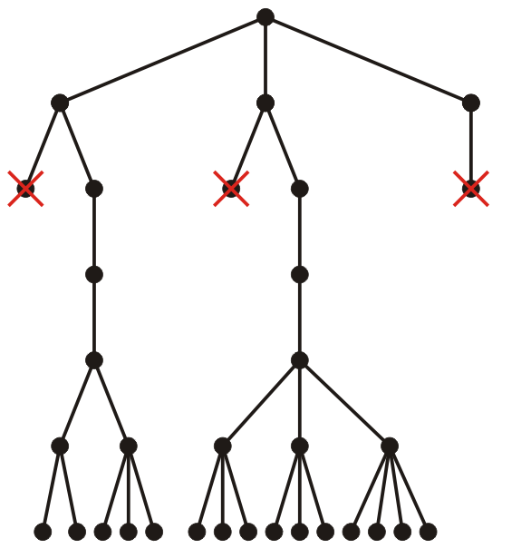
Sudoku
It may seem that this is a reasonably straight-forward method; however, the decision tree continues to branch quick once we start filling the second square

Slide 52
Sudoku
A binary tree of this height would have around 2⁵⁴ – 1 nodes
Fortunately, as we get deeper into the tree, more get cut

Slide 53
Implementation
Our straight-forward implementation takes a 9 × 9 matrix
Default entries are values from 1 to 9, empty cells are 0
Two helper functions:
bool next_location( int[9][9], int &i, int &j )
Finds the next empty location returning false if none is found
bool is_valid( int[9][9], int i, int j, int value )
Checks if there are any conflicts created if matrix[i][j] is assigned value
The backtracing function:
Finds the next unoccupied cell
For each value from 1 to 9, it checks if it is valid to insert it there
If so, backtracking is called recursively on the matrix with that entry set
The main function creates the initial matrix and calls backtrack

Slide 54
Implementation
// Find the next empty location in 'matrix'
// If one is found, assign 'i' and 'j' the indexes of that entry
// Otherwise, return false
// - In this case, the values of 'i' and 'j' are undefined
bool next_location( int matrix[9][9], int &i, int &j ) {
for ( int i1 = 0; i1 < 3; ++i1 ) {
for ( int j1 = 0; j1 < 3; ++j1 ) {
for ( int i2 = 0; i2 < 3; ++i2 ) {
for ( int j2 = 0; j2 < 3; ++j2 ) {
i = 3*i1 + i2;
j = 3*j1 + j2;
// return 'true' if we find an // unoccupied entry
if ( matrix[i][j] == 0 )
return true;
}
}
}
}
return false; // all the entries are occupied
}
// If 'value' already appears in
// - the row 'm'
// - the column 'n'
// - the 3x3 square of entries it (m, n) appears in
// return false, otherwise return true
bool is_valid( int matrix[9][9], int m, int n, int value ) {
// Check if 'value' already appears in either a row or column
for ( int i = 0; i < 9; ++i ) {
if ( (matrix[m][i] == value) || ( matrix[i][n] == value ) )
return false;
}
// Check if 'value' already appears in either a row or column
int ioff = 3*(m/3);
int joff = 3*(n/3);
for ( int i = 0; i < 3; ++i ) {
for ( int j = 0; j < 3; ++j ) {
if ( matrix[ioff + i][joff + j] == value )
return false; // 'value' already in the 3x3 square
}
}
return true; // 'value' could be added
}

Slide 55
Implementation
bool backtrack( int matrix[9][9] ) {
int i, j;
// If the matrix is full, we are done
if ( !next_location( matrix, i, j ) ) {
return true;
}
for ( int value = 1; value <= 9; ++value ) {
if ( is_valid( matrix, i, j, value ) ) {
// Assume this entry is part of the // solution--recursively call backtrack
matrix[i][j] = value;
// If we found a solution, return
// otherwise, reset the entry to 0
if ( backtrack( matrix ) ) {
return true;
} else {
matrix[i][j] = 0;
}
}
}
// No solution found--reset the entry to 0
return false;
}

Slide 56
Implementation
int main() {
int matrix[9][9] = {
{5, 0, 4, 0, 0, 0, 0, 6, 0},
{0, 6, 0, 3, 0, 0, 1, 0, 0},
{0, 9, 2, 5, 4, 0, 0, 0, 0},
{6, 0, 8, 0, 0, 1, 0, 0, 0},
{0, 0, 0, 8, 0, 4, 0, 0, 0},
{0, 0, 0, 2, 0, 0, 6, 0, 1},
{0, 0, 0, 0, 9, 5, 8, 1, 0},
{0, 0, 1, 0, 0, 2, 0, 3, 0},
{0, 8, 0, 0, 0, 0, 2, 0, 7}
};
// If found, print out the resulting matrix
if ( backtrack( matrix ) ) {
for ( int i = 0; i < 9; ++i ) {
for ( int j = 0; j < 9; ++j ) {
std::cout << matrix[i][j] << " ";
}
std::cout << std::endl;
}
}
return 0;
}

Slide 57
Implementation
In this case, the traversal:
Recursively calls backtrack 874 times
The last one determines that there are no unoccupied entries
Checks if a placement is valid 7658 times
5 | 3 | 4 | 1 | 7 | 8 | 9 | 6 | 2
8 | 6 | 7 | 3 | 2 | 9 | 1 | 4 | 5
1 | 9 | 2 | 5 | 4 | 6 | 3 | 7 | 8
6 | 7 | 8 | 9 | 3 | 1 | 5 | 2 | 4
2 | 1 | 5 | 8 | 6 | 4 | 7 | 9 | 3
3 | 4 | 9 | 2 | 5 | 7 | 6 | 8 | 1
4 | 2 | 3 | 7 | 9 | 5 | 8 | 1 | 6
7 | 5 | 1 | 6 | 8 | 2 | 4 | 3 | 9
9 | 8 | 6 | 4 | 1 | 3 | 2 | 5 | 7

Slide 58
Backtracking
This should give us an idea, however:
Perform a traversal
Do not continue traversing if a current node indicates all descendants are infeasible solutions

Slide 59
Classical applications
Classic applications of this algorithm technique include:
Eight queens puzzle
Knight’s tour
Logic programming languages
Crossword puzzles

Slide 60
Eight queens puzzle
Arrange eight queens on a chess board so that no queen can take another
♕

Slide 61
Knight’s tour
Have a knight visit all the squares of a chess board either as a path or a cycle
♘

Slide 62
Logic programming languages
Consider the Prolog programming language where we state facts:
female(juliana).
male(bernhard).
female(beatrix).
male(claus).
male(firso).
female(mabel).
male(constantijn).
female(laurentien).
female(catharina).
female(alexia).
female(ariane).
female(luana).
female(zaria).
female(eloise).
male(claus_ii).
female(leonore).
parent(willem, catharina).
parent(maxima, catharina).
parent(willem, alexia).
parent(maxima, alexia).
parent(willem, ariane).
parent(maxima, ariane).
parent(firso, luana).
parent(mabel, luana).
parent(firso, zaria).
parent(mabel, zaria).
parent(constantijn, eloise).
parent(laurentien, eloise).
parent(constantijn, claus_ii).
parent(laurentien, claus_ii).
parent(constantijn, leonore).
parent(laurentien, leonore).
parent(beatrix, willem).
parent(claus, willem).
parent(beatrix, friso).
parent(claus, friso).
parent(beatrix, constantijn).
parent(claus, constantijn).
parent(juliana, beatrix).
parent(bernhard, beatrix).
parent(juliana, irene).
parent(bernhard, irene).
parent(juliana, margriet).
parent(bernhard, margriet).
parent(juliana, christina).
parent(bernhard, christina).
spouses(willem, maxima).
spouses(firso, mabel).
spouses(constantinjn, laurentien).
spouses(beatrix, claus).
spouses(juliana, bernhard).

Slide 63
Logic programming languages
You can now define relationships between individuals
% Relationships
mother(M, X) :- parent(M, X), female(M).
father(F, X) :- parent(F, X), male(F).
sister(S, X) :- sibling(S, X), female(S), \+ (S = X).
brother(B, X) :- sibling(B, X), male(B), \+ (S = X).
grandparent(G, X) :- parent(G, P), parent(P, X).
% Symmetric
spouses(X, Y) :- spouses(Y, X);
sibling(X, Y) :- parent(P, X), parent(P, Y), \+ (X = Y).
cousin(X, Y) :- parent(A, X), parent(B, Y), sibling(A, B).
% Antisymmetric
uncle(U, X) :- male(U), sibling(U, Y), parent(Y, X).
uncle(U, X) :- male(U), spouse(U, Z), sibling(Z, Y), parent(Y, X).
aunt(A, X) :- female(A), parent(Y, X), sibling(A, Y).
aunt(A, X) :- female(A), spouse(A, Z), sibling(Z, Y), parent(Y, X).

Slide 64
Logic programming languages
Given these relationships, you can now make queries:
cousin(zaria, alexia).
uncle(constantijn, alexia).
aunt(laurentien, alexia).
Backtracking can be used to determine whether the above relationships hold given the stated facts

Slide 65
Parsing
Question: how do we define a programming language?
Why are any of the following never valid?
a + < b
c[3)
d?e;
54f
""";
g$ = "Hello world!";
Programming languages are defined by grammars
The C++ programming language grammar is available here:
http://www.nongnu.org/hcb/

Slide 66
Parsing and grammars
Consider just the conditional statements from the pre-processor
Square brackets is used to indicate something is optional
<group> ::= <group-part>
<group> <group-part>
<group-part> ::= <if-section>
<control-line>
<if-section> ::= <if-group> [<elif-groups>] [<else-group>] <endif-line>
<if-group> ::= #if <constant-expression> <new-line> [<group>]
#ifdef <identifier> <new-line> [<group>]
#ifndef <identifier> <new-line> [<group>]
<elif-groups> ::= <elif-group>
<elif-groups> <elif-group>
<elif-group> ::= #elif <constant-expression> <new-line> [<group>]
<else-group> ::= #else <new-line> [<group>]
<endif-line> ::= #endif <new-line>

Slide 67
Parsing and grammars
We cannot work with a full grammar for C++
Instead, we will consider some vastly oversimplified versions
<digit> ::= 0 | 1 | 2 | 3 | 4 | 5 | 6 | 7 | 8 | 9
<pos> ::= <digit> | <digit><pos>
<int> ::= <pos> | +<pos> | -<pos>
<std> ::= <int>.<pos> | .<pos> | -.<pos> | +.<pos>
<sci> ::= <int>e<int> | <int>E<int> | <std>e<int> | <std>E<int>
<float> ::= <std> | <sci>
<nondigit> ::= A | B | … | Z | a | b | … | z | _
<identifier> ::= <nondigit> | <identifier><nondigit> | <identifier><digit>
<declaration> ::= int <identifier> = <identifier>;
| int <identifier> = <int>;
| double <identifier> = <int>
| double <identifier> = <float>

Slide 68
Parsing and grammars
As you can see, each of these defines a tree
Some of these trees are recursively defined
<digit> ::= 0 | 1 | 2 | 3 | 4 | 5 | 6 | 7 | 8 | 9
<pos> ::= <digit> | <digit><pos>
<int> ::= <pos> | +<pos> | -<pos>
<std> ::= <int>.<pos> | .<pos> | -.<pos> | +.<pos>
<sci> ::= <int>e<int> | <int>E<int> | <std>e<int> | <std>E<int>
<float> ::= <std> | <sci>
<nondigit> ::= A | B | … | Z | a | b | … | z | _
<identifier> ::= <nondigit> | <identifier><nondigit> | <identifier><digit>
<declaration> ::= int <identifier> = <identifier>;
| int <identifier> = <int>;
| double <identifier> = <int>
| double <identifier> = <float>

Slide 69
Parsing and grammars
Suppose we are trying to parse the string
int var0 = 3532700;
double var1 = 3.5e-27;
double var2 = -44.203;
What if we’re parsing garbage?
double var0 = 3.5g-27;
int 1var = 44203;
double var2 = 0.0
double var3 = 1.0;

Slide 70
Backjumping
In some cases, the following may occur:
Determining that one leaf does not constitute a solution may simultaneously determine that the corresponding sub-tree does not contain a solution, either
In this case, return to the closest ancestor such that it has not yet been determined that all descendants have been ruled out
This is described as backjumping

Slide 71
Searching a maze
In trying to find your way through a maze, one simple rule works quite nicely:
The right-hand rule:
Touch a wall with your right hand, and continue forward always keeping your right hand touching a wall until you get out.

Slide 72
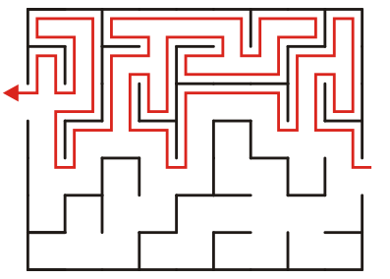
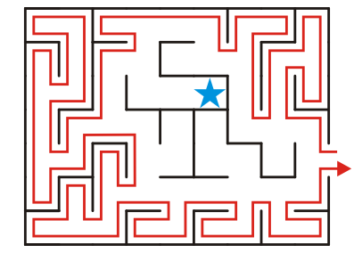
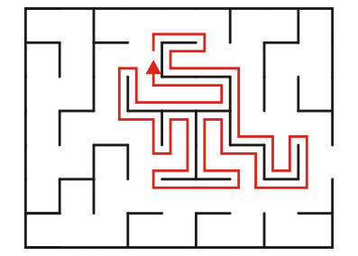
Searching a maze
This works well in finding your way through a maze
It doesn’t work if you’re trying to get into the maze or out of a maze

Slide 73
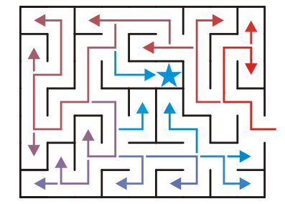
Searching a maze
Consider the following algorithm:
If the goal is reached, we are done
If there is only one move into a previously unoccupied cell, move to it and flag it as occupied
If there is more than one move into a previously unoccupied cell, push that position onto a stack, and take the right-most available path
If there are no more moves, check the stack:
If the stack is empty, there is no path to the goal
If the stack is not empty, pop to top position and continue the algorithm from that point

Slide 74
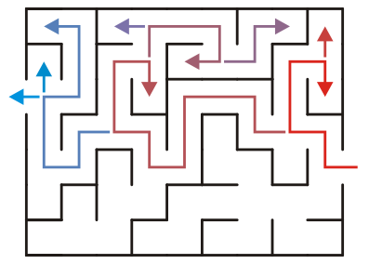
Searching a maze
In each example, the solution is always found
In the normal maze, less work is required due to backjumping

